Slide 1
X-section T-S
See Cross section locations.kmz & Cross section labels.kmz for location in Google Earth

Slide 2
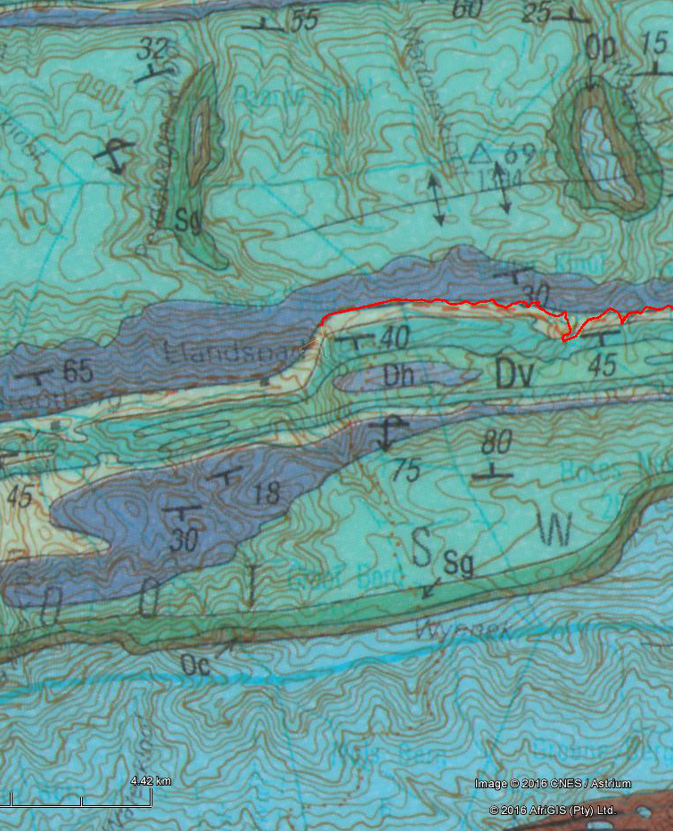

S-T
Db
S
Ss
S
Ss
13.3 km
N
Sg
Ss
Nv, Ng, Nh’ Nd
3320 Ladismith 1:250 000 Geology
Oc
Os
Anticline
Ss
Sg
10 km
Db
Dga
Ss
GS12
Overturned syncline
Dg
Dh
Dv
Dg
Gamkaskloof Project – Schematic Geologic Cross Section
Dga
Dg
Dv
Db
Ss
Db
Db
Dg
Ss
5 km
Ss
Sg
Ss
Oc
Sg
Oc
Oc
Os
Os
Os
T
T
0 km
masl
1500
1000
500
SL
-500
-1000
-1500

